Slide 1

Spfy: speedy predictive genomics
Supervisor: Chad Laing
Student: Kevin Le

Slide 2
Kevin Le
Currently:
BASc Software Engineering (uOttawa)
Focus on applied math
Co-op @NML Lethbridge (8-months)
Previously Completed:
BSc Neuroscience (Dalhousie)
Transgenic mouse models of Alzheimer’s
Cryptography & network security
Software Background:
Largely Python
Linux
Virtualization
Career Goals:
Big-data companies

Slide 3
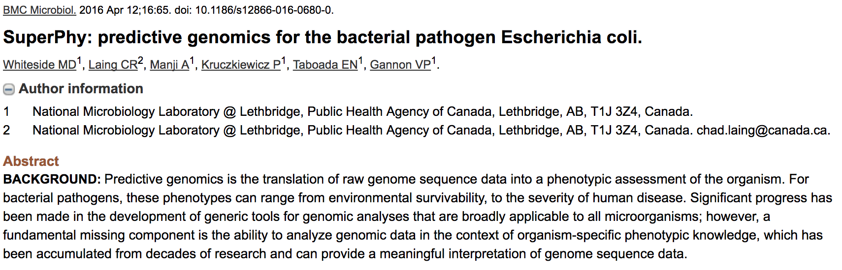
Background

Slide 4
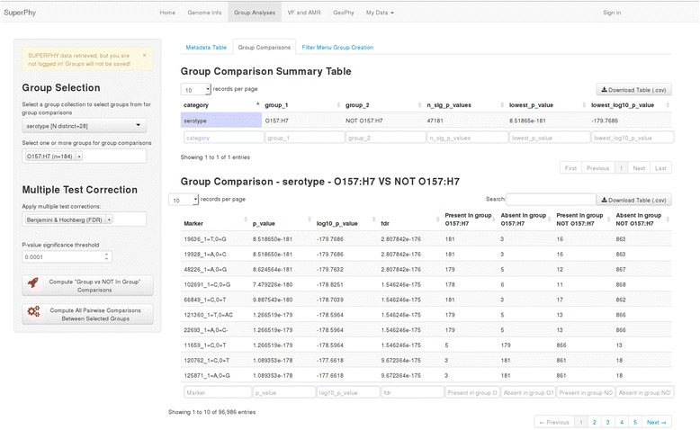
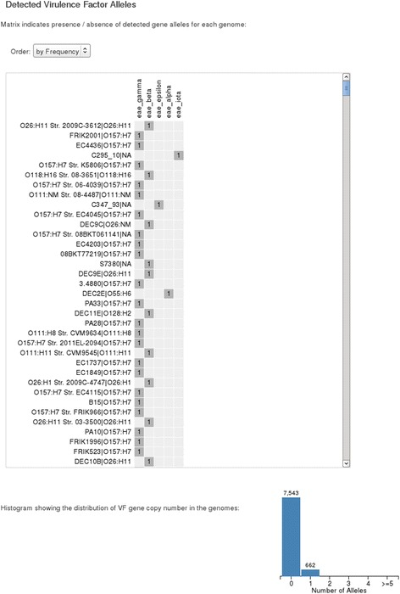
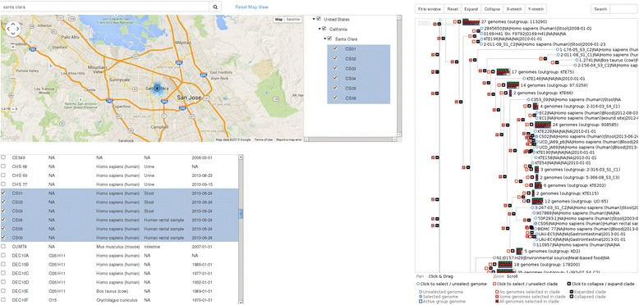
Background: existing functions

Slide 5
The problem
Speed
Simplicity
Scalability
Predict serotype, VF, AMR within a few minutes
More responsive user-interface
Easier to upload genomes and get results
Intuitive navigation of the website
Quickly integrate new analyses & results
Ability to perform group comparisons across thousands of genomes

Slide 6
Challenges deep-dive
Speed
Simplicity
Scalability
Modernize
Task queues
ReactJS
Familiar Design
One click results
Material design (Google)
Technology
Graph database
Pandas, SciPy

Slide 7
Docker

Slide 8
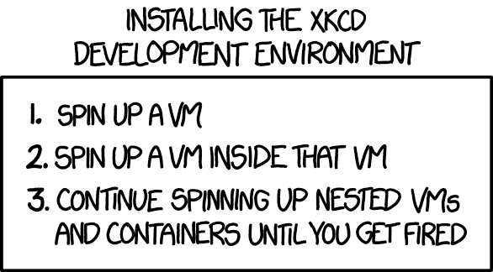
Docker

Slide 9





Solution
Flask API
Scalable uWSGI
Redis Container
Docker Volume
Redis DB
Redis Task Queue
Datafiles /datastore
RQ Worker Container
RQ Worker Container
RQ Worker Container
Priority Workers
4 Workers
Reg. Workers
12 Workers
UID Generation
1 Worker
Speed: task queues
Immediate Results

Slide 10
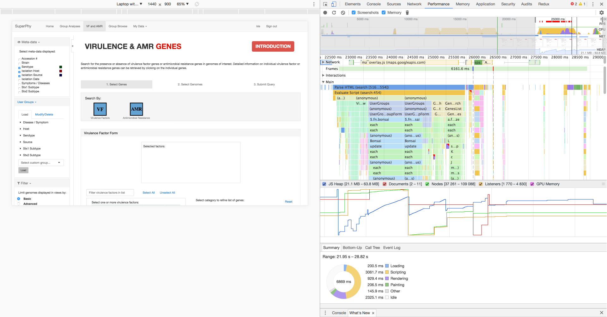

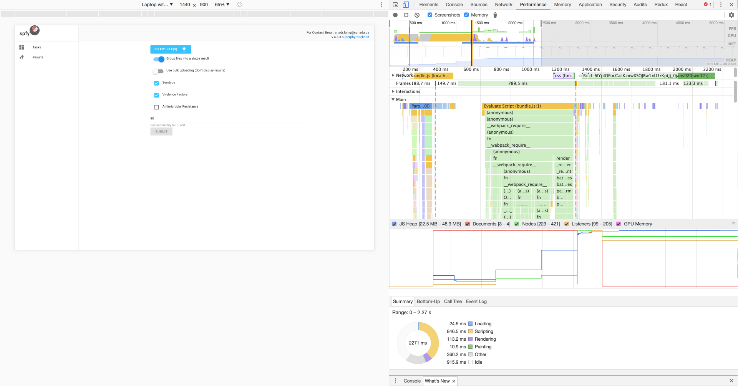
Solution
Speed: ReactJS

Slide 11



Solution
Webserver Container
Reverse Proxy
NGINX
Flask API
Scalable uWSGI
Scientist
Reactapp Container
Front-End
ReactJS
Speed: ReactJS
Docker

Slide 12
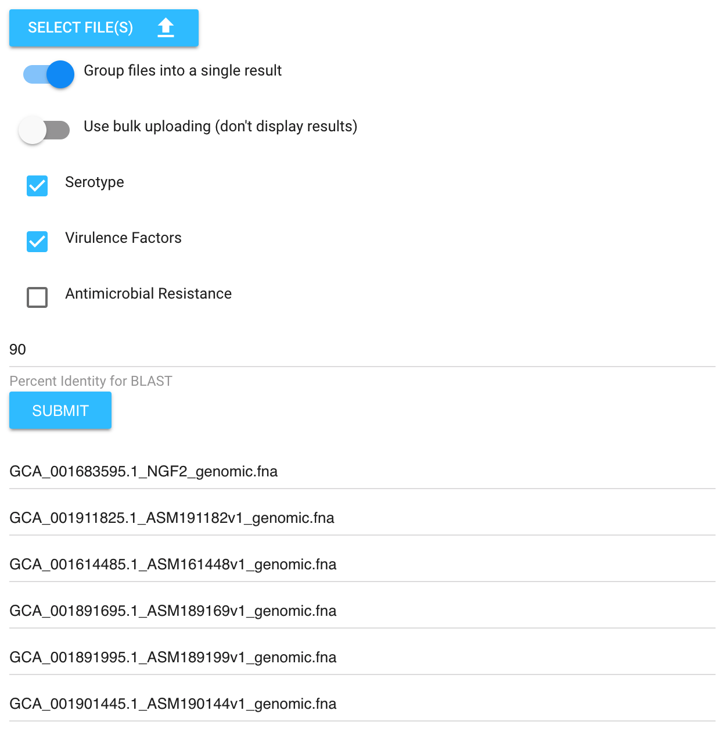
Solution
Simplicity: one-click results
Notes:
One of the benefits of our task queues, is that we can easily distribute work and just run for everything, not specific VFs or AMRs

Slide 13
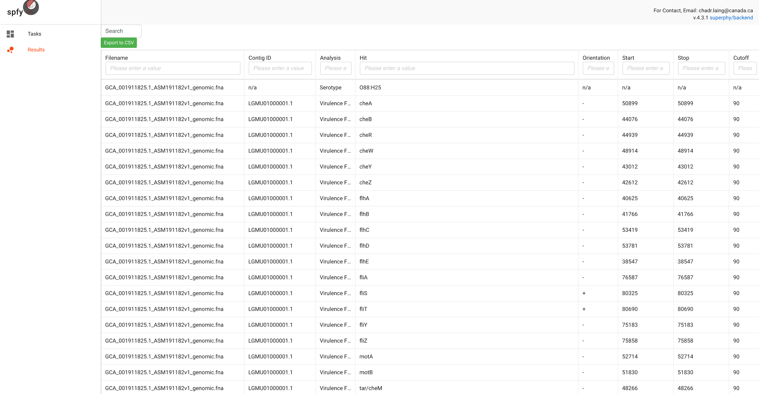
Solution
Simplicity: one-click results
Notes:
One of the benefits of our task queues, is that we can easily distribute work and just run for everything, not specific VFs or AMRs

Slide 14
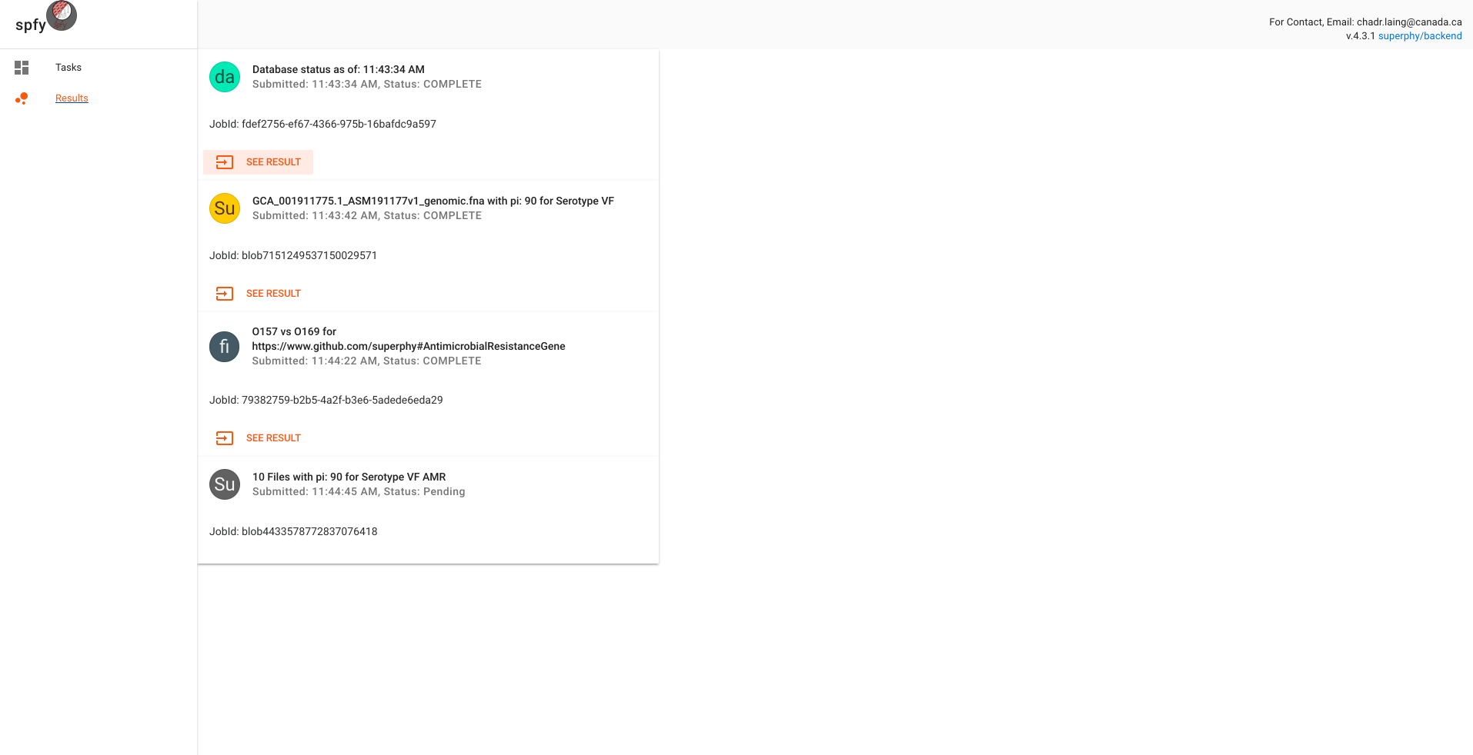
Solution
Simplicity: material design
Card Based
Notes:
Material Design: used by Google, familiar to users.
Card Based: You’ll see this card based design reused throughout.

Slide 15
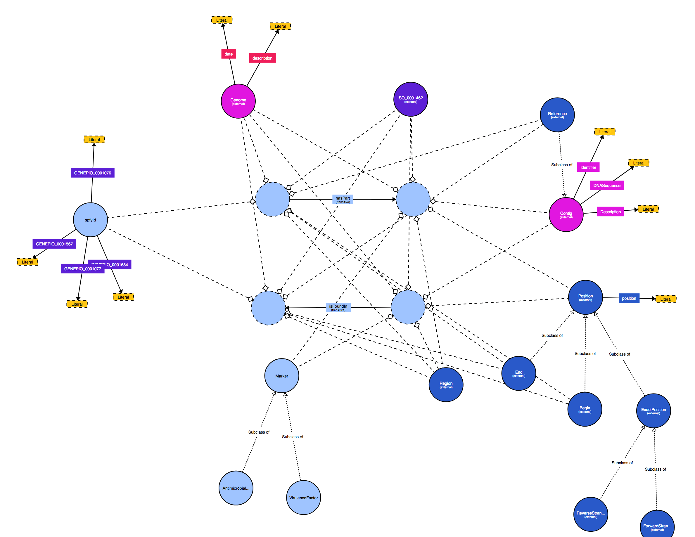
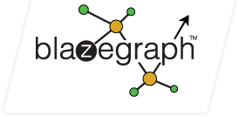
Solution
Scalability: graph database
Semantic Web
Notes:
Material Design: used by Google, familiar to users.
Card Based: You’ll see this card based design reused throughout.

Slide 16
Solution
Blazegraph Container (LTS)
Graph Database
Blazegraph
RQ Worker Container
RQ Worker Container
RQ Worker Container
Scalability: graph database
Priority Workers
4 Workers
Reg. Workers
12 Workers
UID Generation
1 Worker
Docker
Notes:
Material Design: used by Google, familiar to users.
Card Based: You’ll see this card based design reused throughout.

Slide 17


Solution
Scalability: pandas, scipy
Python Wrappers to C Code
Notes:
Material Design: used by Google, familiar to users.
Card Based: You’ll see this card based design reused throughout.

Slide 18
Implementation

Slide 19
Wrapper for serotype, VF, AMR
Upload to graph database
Docker
QC / CI
Initial Deployment
January
February
March
April
Task queues
API (Flask)
Basic website (AngularJS)
Graph traversals
Group comparisons: backend code (Flask)

Slide 20
Implemented subtyping in React
Read the Docs
Paper writing
May
June
July
August
Group comparisons: frontend code (ReactJS)
2nd deployment
Refactor backend
Additional features
3rd deployment

Slide 21
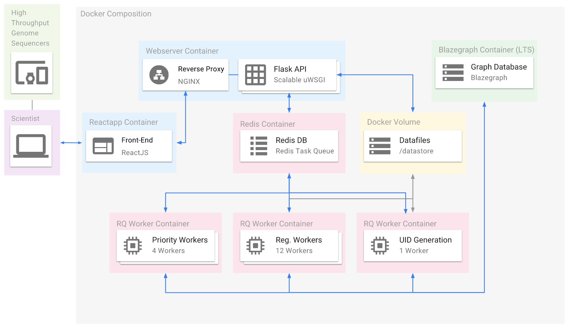
End Result
Platform Architecture

Slide 22
Live Demo

